Slide 1




PERSONALIZED INTERVENTION FOR ALCOHOL CONSUMPTION
ÖMER FARUK SATIK 150210330
ABDULLAH AYDOĞAN 150230731
1

Slide 2

RELATED WORK
A Machine Learning Approach to Predicting Alcohol Consumption in Adolescents From
The project mentioned in the article converts the content of high school students' text messages into numerical vectors using a neural network called doc2vec and predicts substance use with logistic regression.
Bergh, A. M. M. (2019). A Machine Learning Approach to Predicting Alcohol Consumption in Adolescents From Historical Text Messaging Data (Doctoral dissertation, Chapman University).
https://bulutistan.com/blog/nlp-natural-language-processing/
2

Slide 3
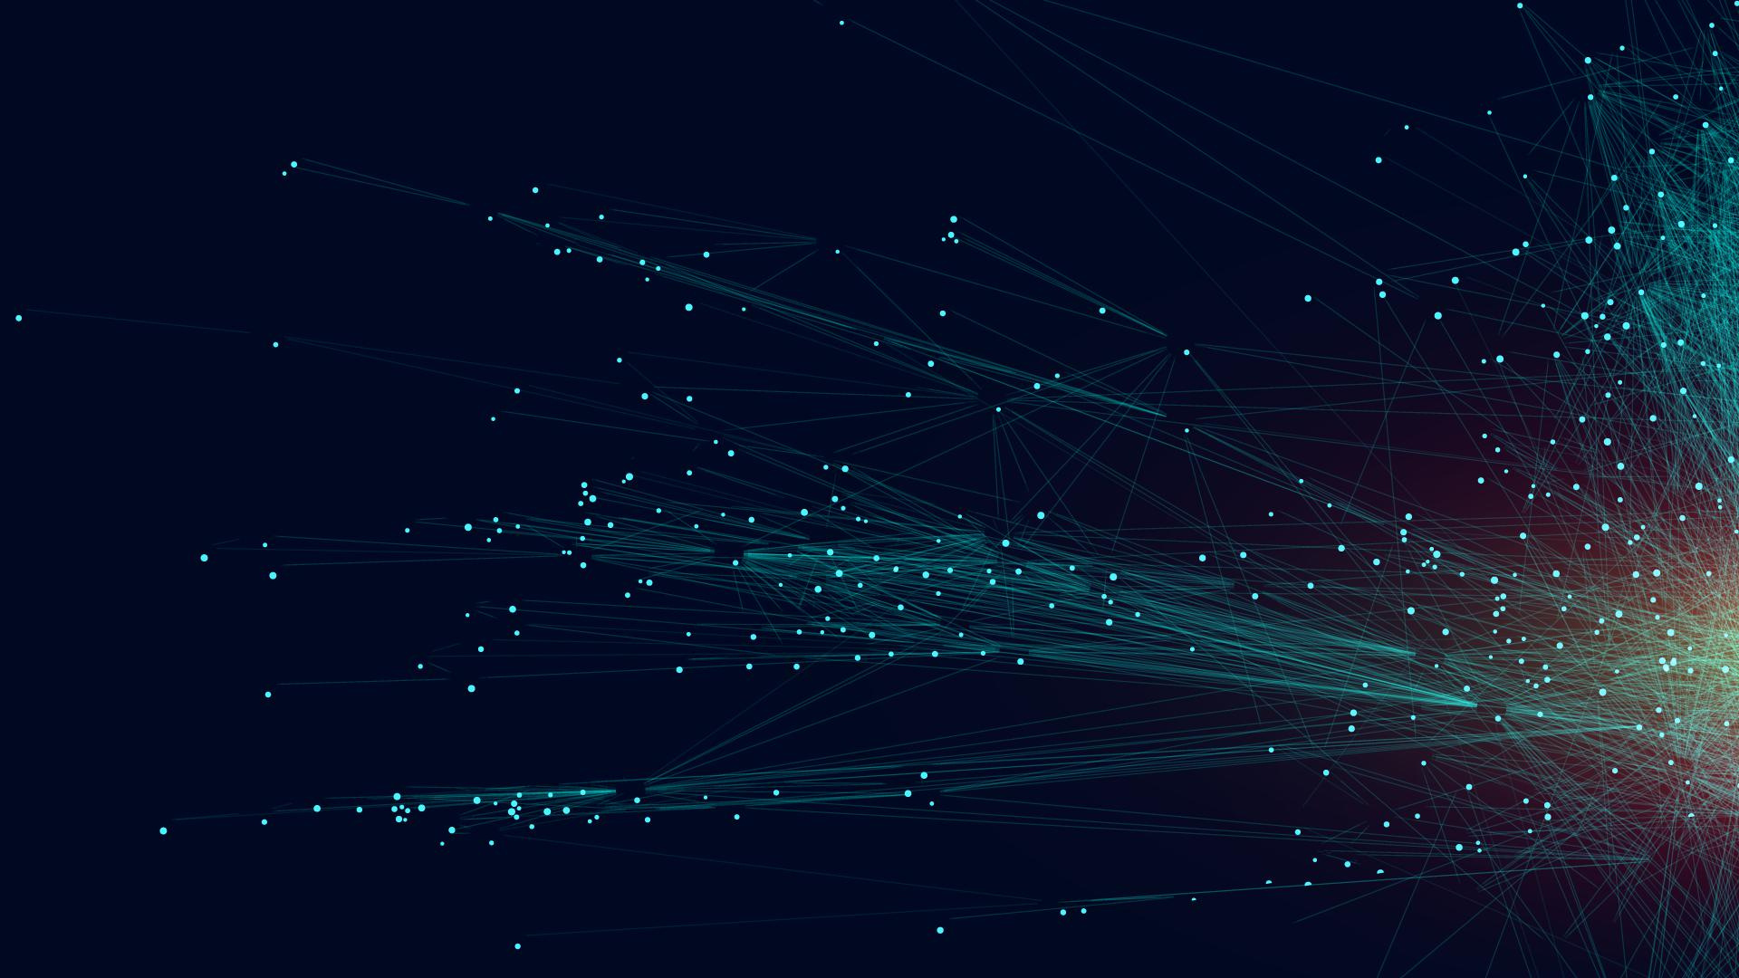
Approximately 1 million rows
23 columns
Numerical type features
No null values
26 duplicated rows
Dataset
Alcohol and cigarette use status according to some physical and blood values
3

Slide 4
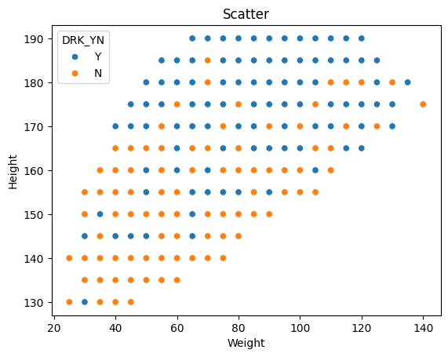
VISUAL ANALYZES
As height and weight increase, drinking rate increases.
Age may be the reason for this situation.
4

Slide 5
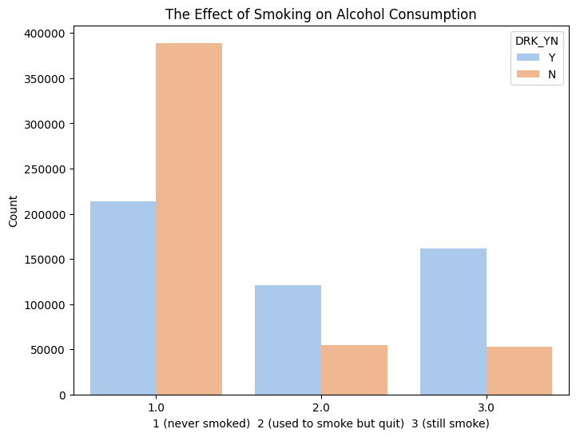
VISUAL ANALYZES
Smoking directly affects alcohol consumption.
5

Slide 6
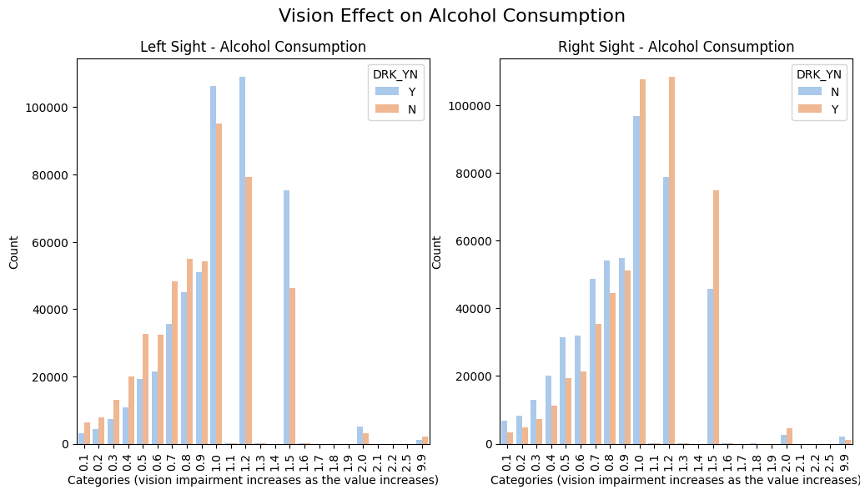
VISUAL ANALYZES
Vision has no direct effect.
6

Slide 7
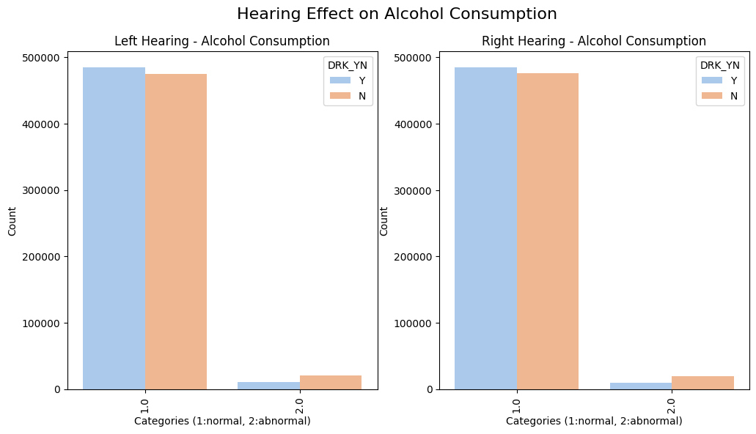
VISUAL ANALYZES
Considering the rarity of deafness,
Hearing, like vision, has no direct effect.
7

Slide 8
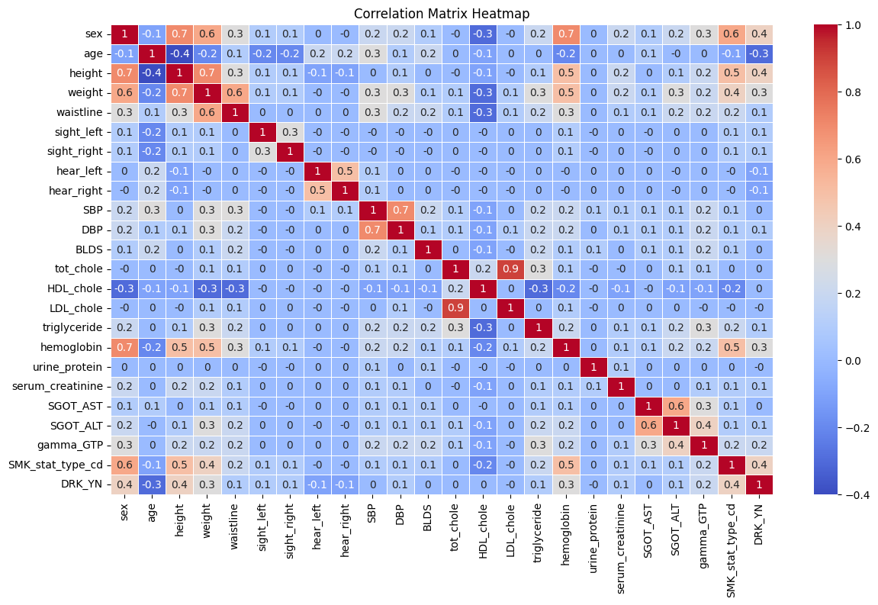
VISUAL ANALYZES
8

Slide 9
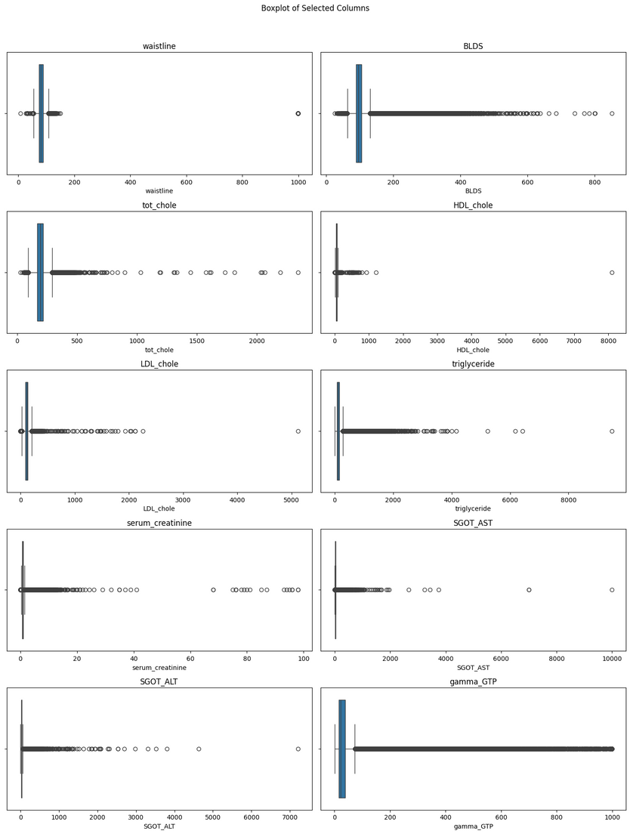
VISUAL ANALYZES
Features we suspect include outliers
9

Slide 10
Feature Engineering
Reducing the number of columns by creating meaningful new columns by combining existing features
Data Preprocessing
Encoding
Converting the new categorical features produced into numerical by encoding them
Scaling
Standard Scaling
Robust Scaling
10

Slide 11
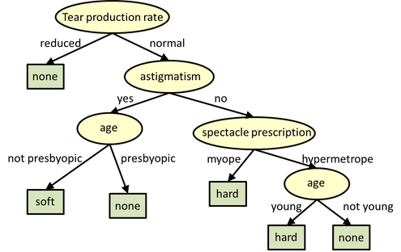
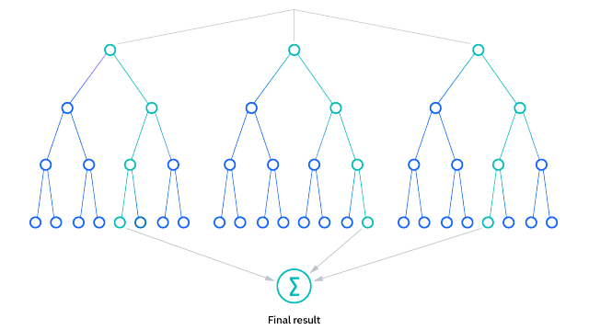
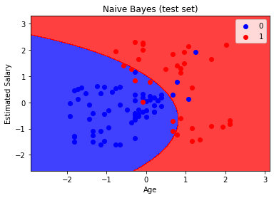
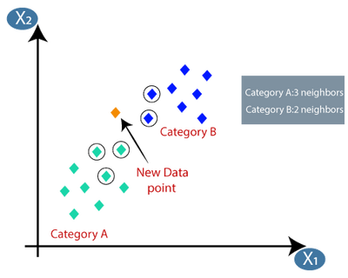
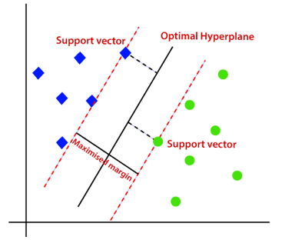

MODEL DEVELOPMENT
0.63
0.71
0.68
0.67
-
Decision Tree
Random Forest
Gaussian Naive Bayes
k-Nearest Neighbors (KNN)
Support Vector Classifier
11

Slide 12

FURTHER DEVELOPMENT
Optimization of outlier data detection
Principal Component Analysis
12

Slide 13
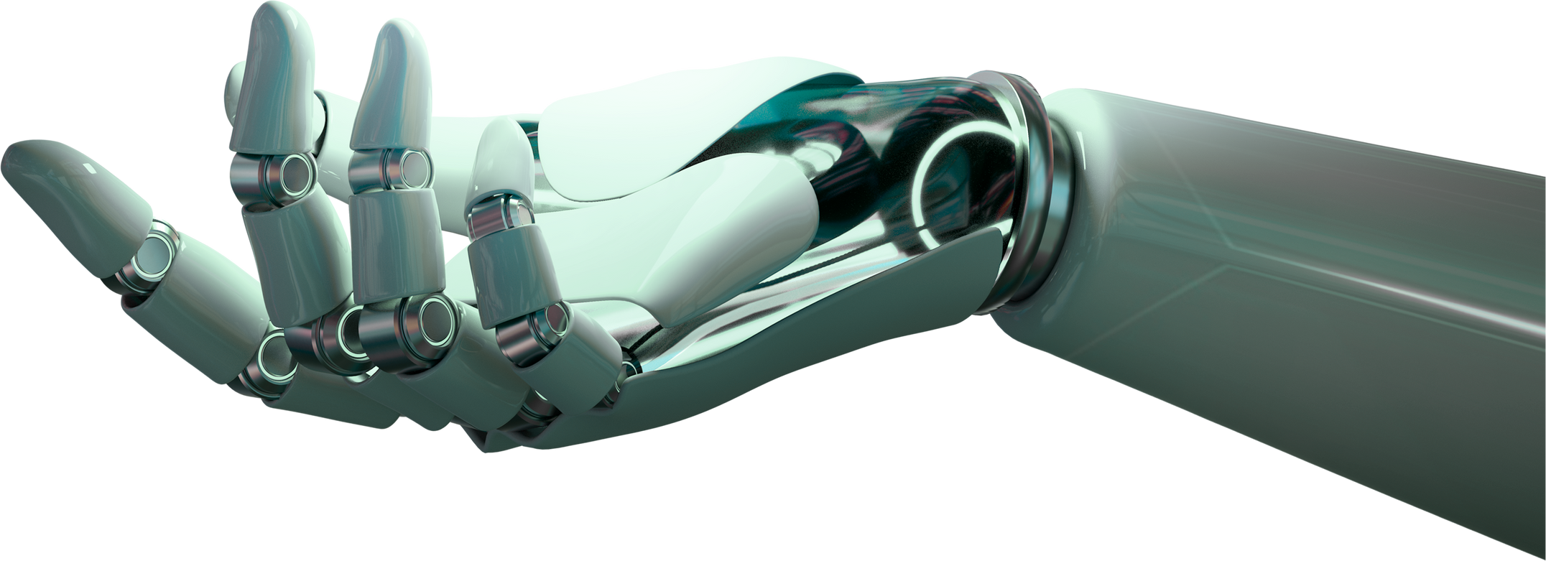
FURTHER DEVELOPMENT
Random Sampling
Gridsearch CV
RF
Best parameters: {'criterion': 'gini', 'max_depth': 10, 'n_estimators': 200}
SVC
Highly cost
0.7103
13

Slide 14

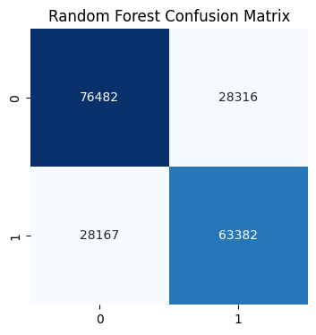
CONCLUSION
0.7123
14

Slide 15

FUTURE WORK
Development of the model for all countries of the world
Using the model in ministries of health
A Mobile app providing personalized guidance
15

